Slide 1
Wireless-Enabled Smart-Lights Hub Prototype Senior Design December 2019 Team 16 http://sddec19-16.sd.ece.iastate.edu/
Dr. Manimaran Govindarasu
Dr. Ravikumar Gelli
Alexander Beaver
Ryan Bush
Aaron Ramsey
Logan Zasada

Slide 2
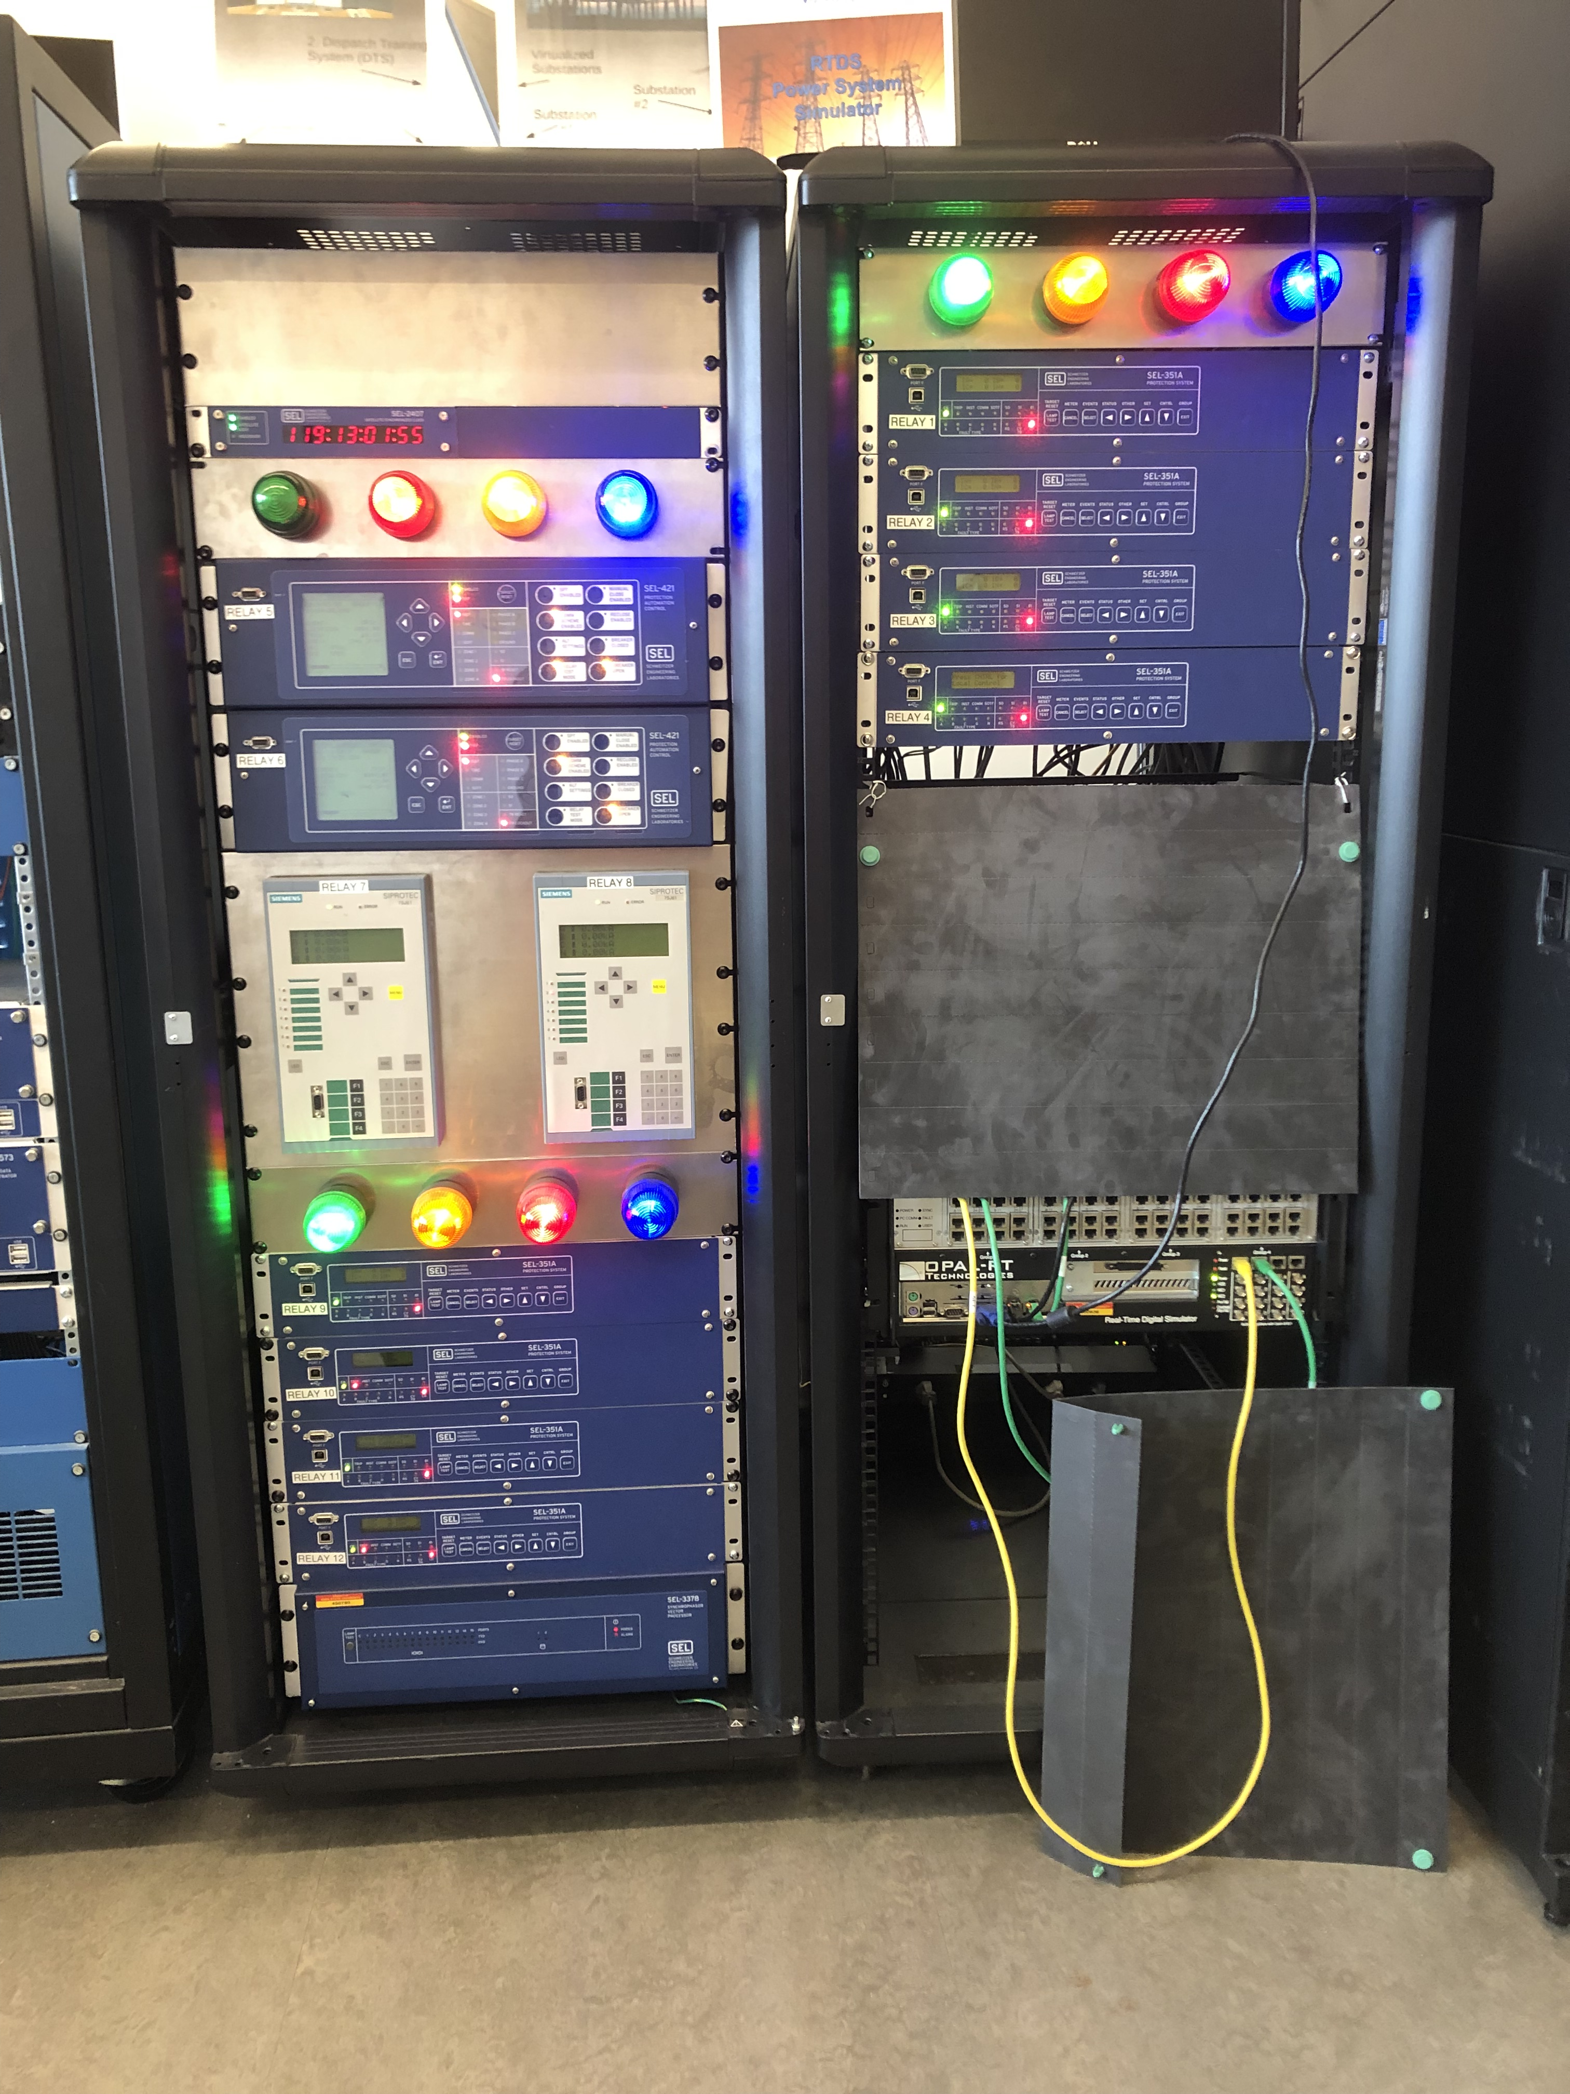
Problem Statement
Light system in PowerCyber lab is not a good representation of simulated power stations.
In charge of making the system more portable.
Current system cannot move out of the lab.
Lack of portability means less outreach opportunity.
Lights should represent power stations in a geographic area
Should be moved around on a magnetic board.
Map overlay can represent anything.

Slide 3
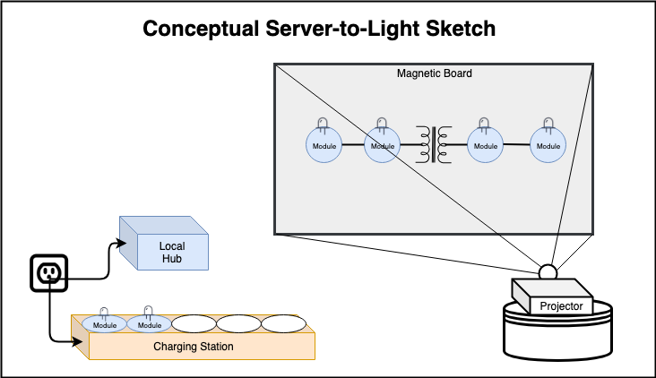
Conceptual Sketch

Slide 4
Functional Requirements
Accept input from 100 relays
Output to 100 IOT lights
Capability to map relay inputs to light outputs via UI
IOT lights should be magnetically mountable
IOT lights should be able to operate continuously for 8 hours
IOT lights should come in at least 4 different colors
IOT lights must be operated wirelessly
System should be capable of charging at least 8 lights at once

Slide 5
Non-Functional Requirements
System should be easy to move through standard door frames
Magnetic mounting board should not obscure any image projected onto it
Light status should update in less than a second when corresponding relay is updated
Relay interface components should be easy to connect
IOT lights should be similar in size to existing solution

Slide 6
Other Constraints & Considerations
Project Constraints:
Time - 2 Semesters
Space - Limited number of units can fit on magnetic board
Technical knowledge – IOT, ZigBee, Arduinos, Raspberry pi, Server database
Light Module constraints:
100 units
Range between units (up to 70-300m for ZigBee)
Battery Life (expected battery of 8-10 hours)
Size per unit
Data Rate (250Kbps for ZigBee)
Cost

Slide 7
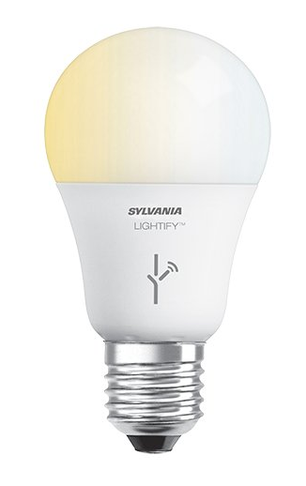
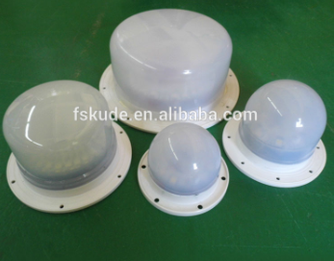
Market Survey
Requirements:
Wirelessly communication
Controlled automatically from relay boxes
8 hour battery life
Rechargeable battery
Available
AC Wireless Lights
Unable to power for 8 hours
DC Battery Powered Wifi
Unable to communicate with properly

Slide 8
Potential Risks
Lack of IOT experience in both circuitry and protocols
Lots of research has been done already
Split off into our areas of focus. Play to individual strengths
Experiment where possible.
Lack of internet protocol knowledge
Offline prototypes where possible
Lithium batteries are always a risk

Slide 9
Resource & Cost Estimate
ETG has provided us with many resources also:
Cords
Breadboards
Header pins
Solder
Note: we still have to decide which path we want to use whether it be ZigBee communication or Radio communication between devices

Slide 10
Project Milestones & Schedule
Working Prototype of each module
Final housing and testing
Up-scaling to 100 units
Full working prototype
May 2019
May/August 2019
October 2019
November 2019

Slide 11
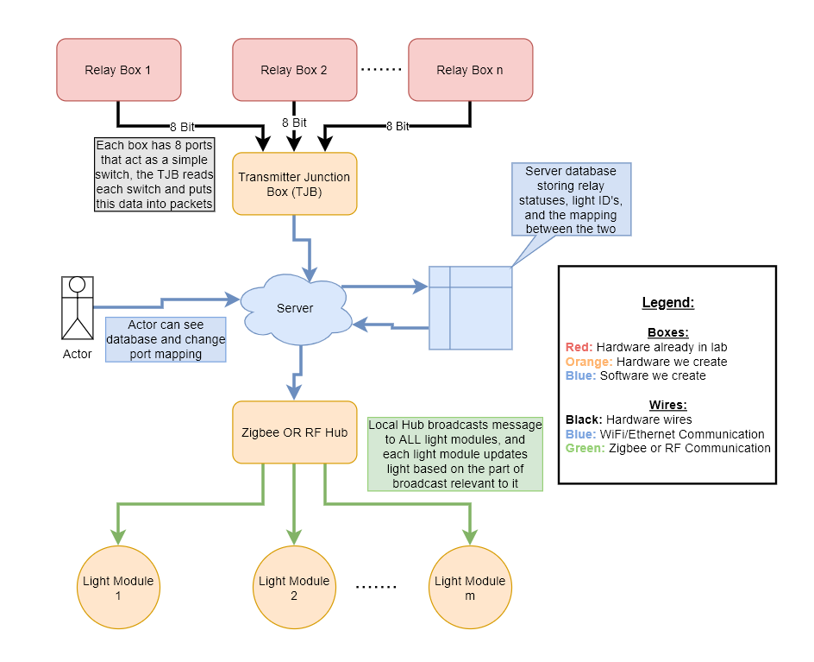
Functional Decomposition

Slide 12
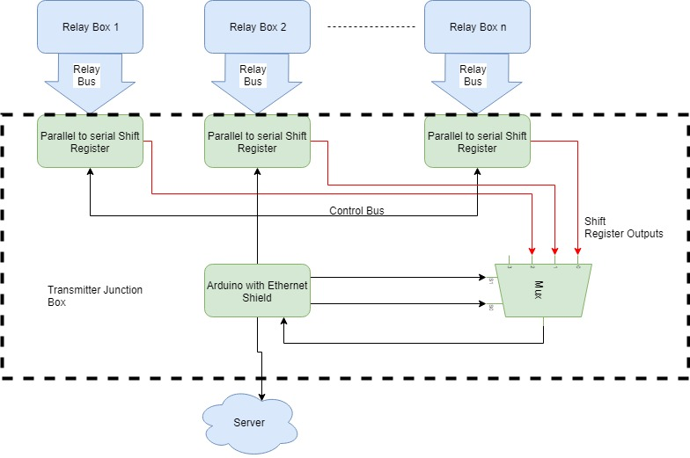
Relay To Server
Modular Scalable Design Hierarchy
100% digital Signaling
Shared control bus
Minimizes µC I/O requirements

Slide 13
Charging Stations
Safety is priority
Simple Design

Slide 14
Server
Facilitates communications between relay and hub
Website will be built in Python using the Django web framework
Framework useful for readily-available admin interface
Endpoints easy to implement
Operates in a VM on a remote servers
Microcontroller could hit API endpoints to update or read local database

Slide 15
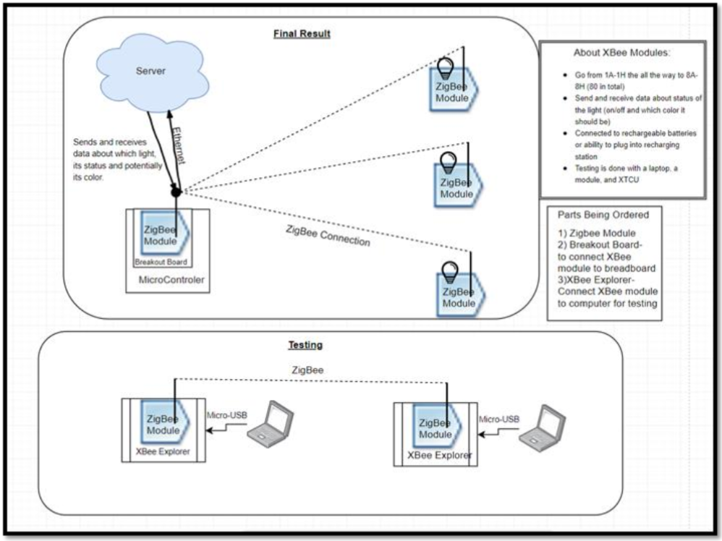
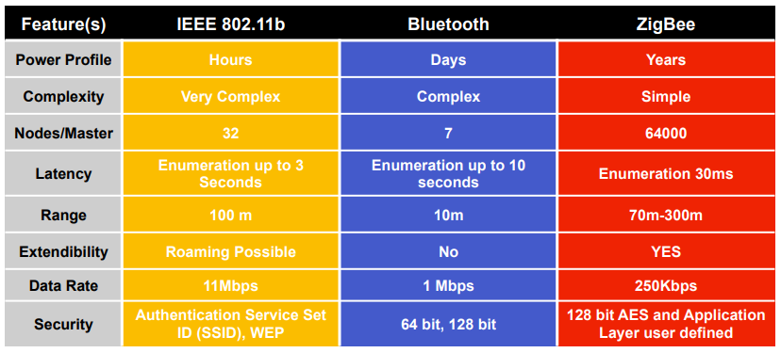
Server To Light

Slide 16
Platforms Used
Relay-to-Server
Arduino
Ethernet
Server
Python
Django
Server-to-Light
Arduino
Raspberry Pi
Wifi/Ethernet
RF
Zigbee
Ultiboard
Multi-Sim
Apache webserver
MySQL
XCTU
Multi-Sim
Ultiboard

Slide 17
Testing
Battery life within 8-12 hours
Give the software to the client and get their opinions on how easy it is to program lights
Software is easy to use
Set up the system in a large lecture hall, with the computer at one end of the lecture hall, and try turning on lights at the other end
System has reasonable range
The time between tripping a contact and the physical light turning on should be within a second
System functions in real-time
Connect as many lights as the PowerCyber lab currently has of ports and see if the system still runs in real-time
System can handle reasonable number of lights updated at the same time
Run multiple lights until the batteries are completely empty, time how long each takes to recharge fully, and discuss with client to see if we have a reasonable charge time
Charges within reasonable time
Light is ready to be turned on and connected to laptop, but the actual light is not on
On 50% of the time (on for certain number of minutes, off for same amount of time)
On 100% of the time
Set up approximately 3 lights in 1 of 3 states:

Slide 18
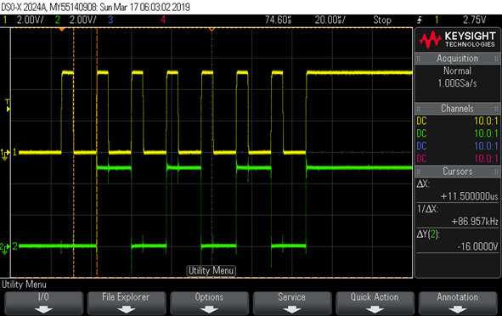
Prototype Implementations
Relay-to-Server
Server-to-Light
Adjusts light status and echoes last known status to confirm proper operation
Development server on localhost communicates with database
Server
Shift Register Tested
Ethernet Tested

Slide 19
Current Status
Relay-to-Server
Server-to-Light
Charging Station
Current implementation of webpage not deployed yet. Still in testing
Server
Have to wait for battery sizing on light modules before we decide how to charge them
Must decide between ZigBee or Radio communication
Need to implement server specific commands
Light modules
Prototyping with both ZigBee and Radio
Can interface between XBee modules using XCTU
Need to integrate relay communication with server communication code

Slide 20
Dead-ends
OpenHAB
Saw a hack online to hack Zigbee AC Lights and program them with Arduino
AC Lights
Tried to use as a hub with OpenHAB and Use XCTU
XBee XStick
First attempt at Zigbee Communication
XBee Gateway
Bought a hub hoping to interface with Zigbee AC Lights
Samsung SmartThings
Open-source Home automation software with tons of documentation, hoped to program the local hub using an OpenHAB Server that interfaced with light modules

Slide 21
Member Responsibilities
Aaron
Alex
Ryan
Logan
Relay-to-Server
Server
Server-to-Light
Server-to-Light

Slide 22
Future
Relay-to-Server
Server
Server-to-Light
Charging Stations
Fully connect in lab
Deploy onto server, build new features, and redeploy. Repeat until server meets requirements
Blocked by light Status
Find proper sized container for module
Decide on a rechargeable battery and magnet
Need to create PCB
Scale to multiple relay boxes
PCB implementation

Slide 23
Questions????

