Slide 1
Wireless-Enabled Smart-Lights Hub Prototype Senior Design December 2019 Team 16 http://sddec19-16.sd.ece.iastate.edu/
Alexander Beaver
Ryan Bush
Aaron Ramsey
Logan Zasada
Alex Nicklaus – Summer Graduate Student
Dr. Ravikumar Gelli - Client
Dr. Manimaran Govindarasu - Advisor

Slide 2
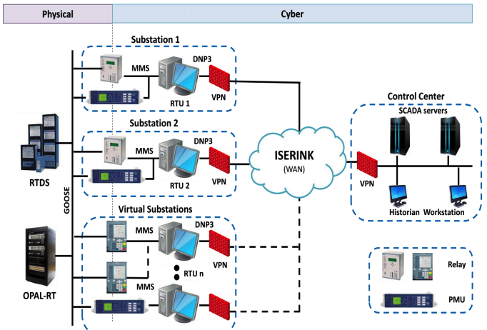
PowerCyber Lab - Customer
Full name is Cybersecurity for Power Systems Laboratory
Research is focused on, "cyber security framework encompassing attack deterrence, prevention, detection, mitigation, resilience, and attribution", as stated on the Iowa State PowerCyber Lab website
PowerCyber CPS Security Testbed Architecture

Slide 3
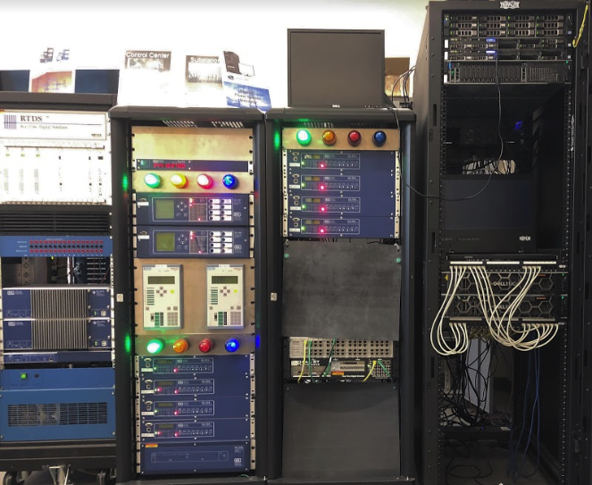
The Problem
Light system in PowerCyber lab cannot represent a large simulated power network
The current system isn't marketable to many audiences
Current system cannot move out of the lab which creates a lack of portability for the system
Lack of portability means less outreach for power grid cyber security opportunities
RTDS, Relays with Lights, and Control Center

Slide 4
Audience
The current system has a limited audience and can be difficult to understand
Current Audience:
People who visit the PowerCyber Lab in Coover
The new system will allow for portability, increased number of power network nodes, user interaction, and a visually aesthetic representation of any grid (ie. Ames, Iowa, USA, etc.) All of these contributions help increase marketability of power cyber security around the globe.
Audience with Wireless Smart-Lights:
Pre, Post, and Current University Students
Industry Professionals
Professors/Researchers in and outside of Ames
Politicians

Slide 5
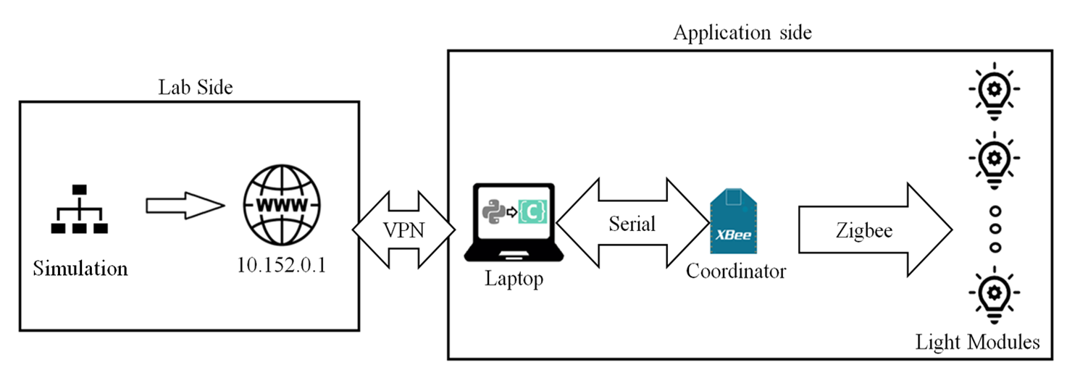
Conceptual Sketch

Slide 6
Light Module Design Requirements
Variable color capability
Zigbee Connectivity
Magnetically Mountable
User interface circuit
On board battery charging circuit
8+ hour battery life
Aesthetically pleasing design

Slide 7
Market Survey
Phillips Hue Go – Smart Light w/ hub
$80
3 hour battery life
E-smart Live Wi-Fi remote lights
$8-$20 per
No documentation
Kude Wi-Fi remote lights
$17
No Documentation
Other
Expensive
120VAC powered

Slide 8
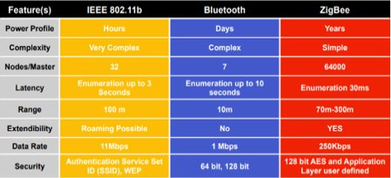
Light Module Design Choices
IOT communication using ZigBEE
RGB LED
MCP 73833 Charging IC
Indicator LEDs

Slide 9
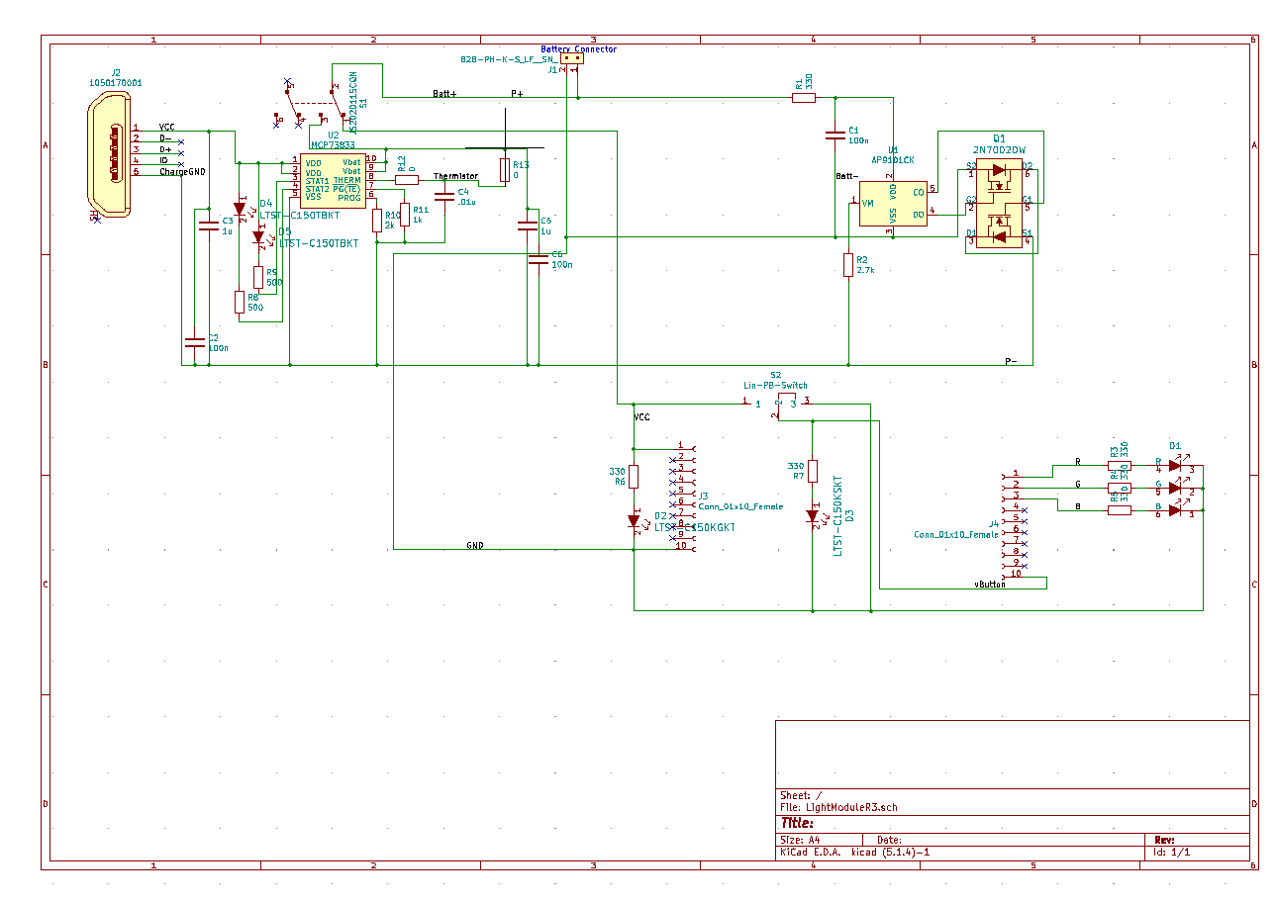
Light Module Schematic

Slide 10
Light Module Layout

Slide 11
Light Module BOM
Part | Cost
Board+Assembly | $37*
Zigbee Module | $20
Battery | $3
Housing | $3
Total | $63
*Purchased en masse

Slide 12
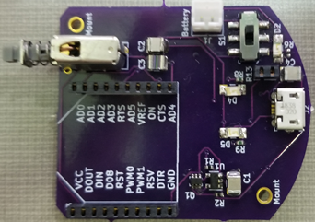
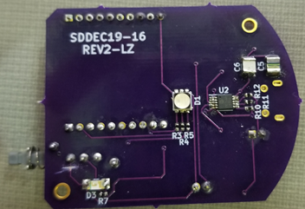
Light Module Design Challenges
Requirements
Clarity for soldering parts on
Making sure everything fits physically
Scalable design
Printing 10's of copies of PCB
Magnet
Loose magnet inside module might short battery terminals

Slide 13
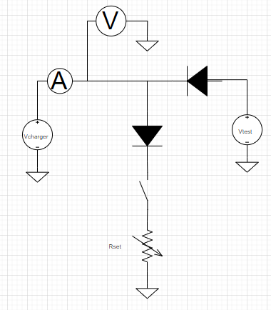
Light Module Testing
Functional Testing
Digi XCTU
Reverse communication
Charge Circuit Testing
Software for hardware verification
Lifetime testing

Slide 14
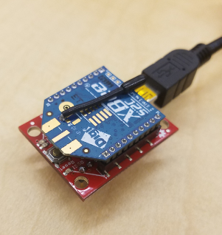
Coordinator Module
Functional Testing
Digi XCTU
Reverse communication from endpoint

Slide 15
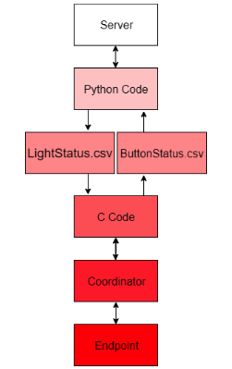
Software Design Requirements
Interface with PowerCyber lab's system
PowerCyber lab writes to LightStatus.csv
PowerCyber lab reads from ButtonStatus.csv
Capable of running on most laptops / Raspberry Pi
Legible and understandable code

Slide 16
Software Design

Slide 17
Software Challenges
Ensure that the entire packet was received before continuing
Ensuring that the integrity of the CSV files were not lost when writing to them
Best way to read packet from the coordinator.
Fitting code into an existing system

Slide 18
Software: Potential design improvements
Create a more robust C ZigBee API
Expand into a GUI
Light scripting system for automation

Slide 19
Project Challenges
Constantly evolving design
IOT communication
Vague requirements at times
Additional engineering support
Limited time
Creating an enclosure

Slide 20
Demo

Slide 26
Questions?

Slide 27
Other Prototypes

Slide 28
Resources Used in Presentation
PowerCyber Lab Website - http://powercybersec.ece.iastate.edu/powercyber/welcome.php

